Slide 1

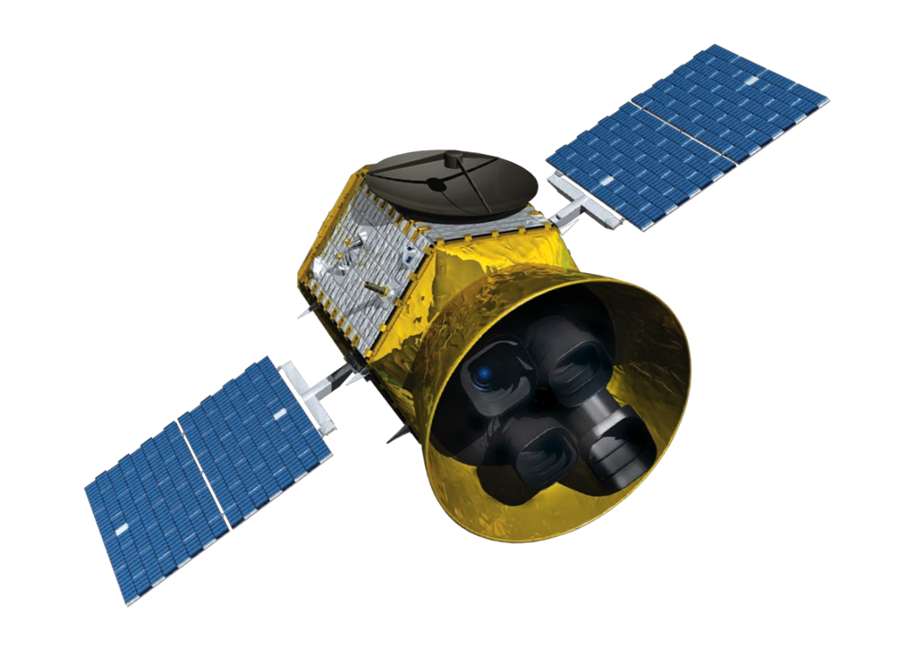
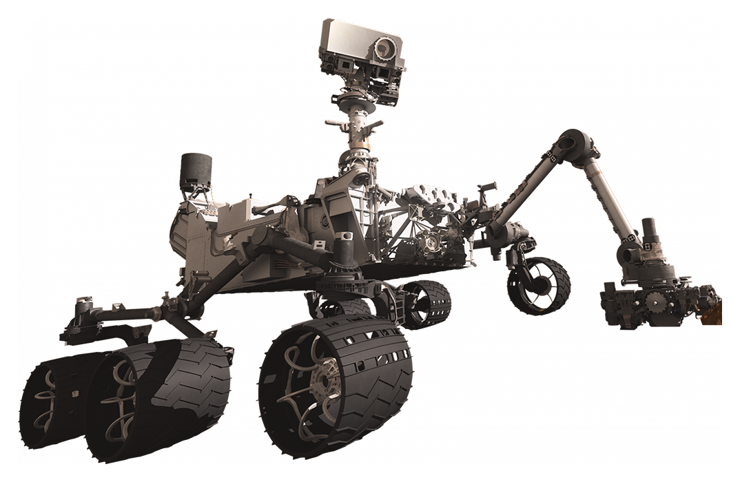
Capstones
Labs
Fall 2025
Spring 2026
Fall 2026
Spring 2027
Fall 2027
Spring 2028
Fall 2028
Spring 2029
16.85
16.811
Course XVI Undergraduate Program
Capstone and Laboratory Schedule
2025-2028
16.405
16.831
16.82
16.83
16.821
16.405
16.831
16.85
16.82
16.811
16.83
16.405
16.821
16.85
16.831
16.82
16.405
Flight Vehicle Engineering
Space Systems Engineering
Design and Testing of Autonomous Vehicles
16.82, 16.821, 16.811
16.83, 16.831, 16.811
16.85, 16.405

